Slide 1
Implement the different distance methods like Euclidean & Manhattan with prediction, test score, and confusion matrix.
ML Practical – 6 A

Slide 2
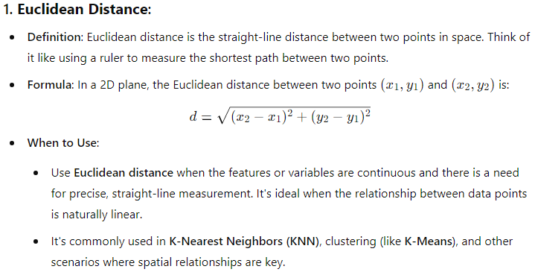

Slide 3
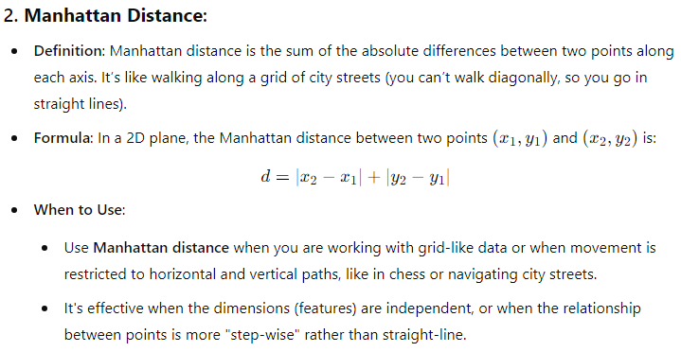

Slide 4
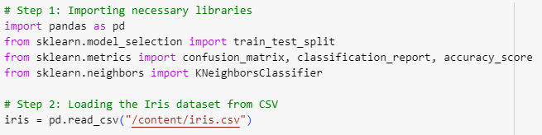

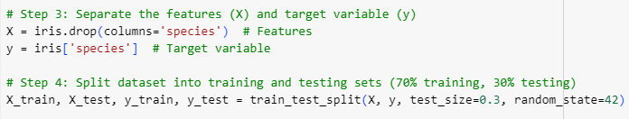


Slide 5
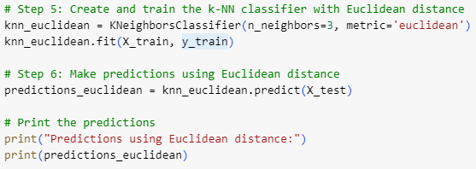




Slide 6
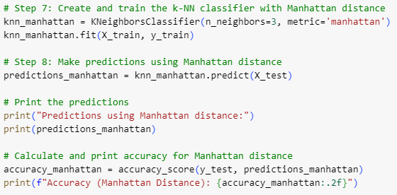


Slide 7
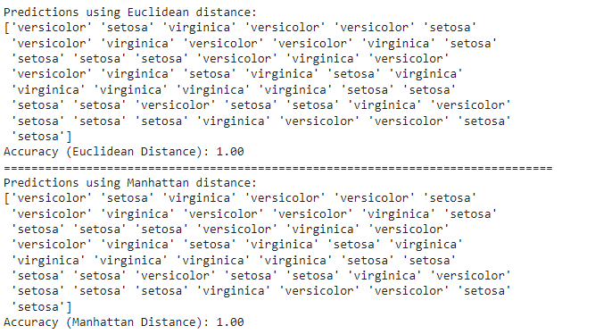
Predictions are made on the test set using both the Euclidean and Manhattan distance metrics. The results show the predicted species of the iris flowers for each sample in the test set, with both distance methods achieving an accuracy of 1.00, indicating that all predictions were correct.

Slide 8
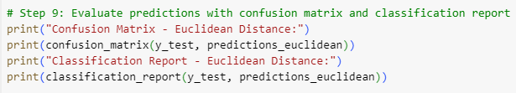
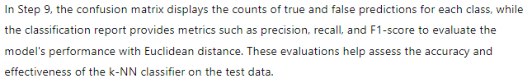

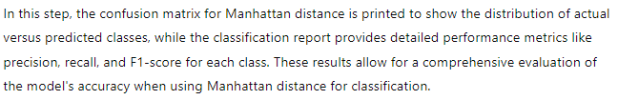

Slide 9
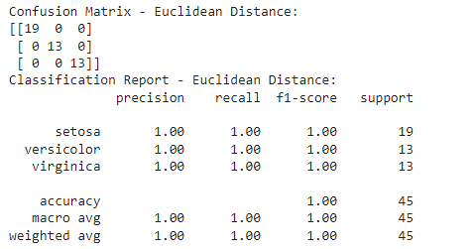
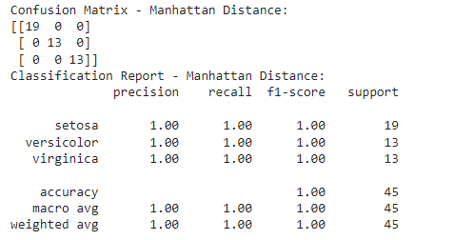
The confusion matrices for both the Euclidean and Manhattan distance methods show perfect classification results, with all 45 predictions correctly identifying the species of iris flowers. The classification reports further confirm this accuracy, with precision, recall, and F1-scores all reaching 1.00 for each species, indicating that the model performed flawlessly on the test set.
The test score refers to the accuracy of the model on the test set. In this case, both the Euclidean and Manhattan distance classifiers achieved an accuracy of 1.00, meaning that all predictions were correct for the test set.

Slide 10
Implement the classification model using clustering for the following techniques with k-means clustering with prediction, test score, and confusion matrix.
ML Practical – 6 B

Slide 11
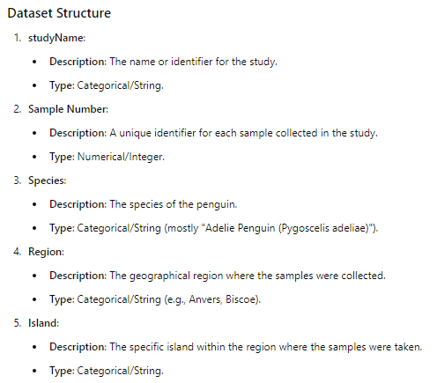
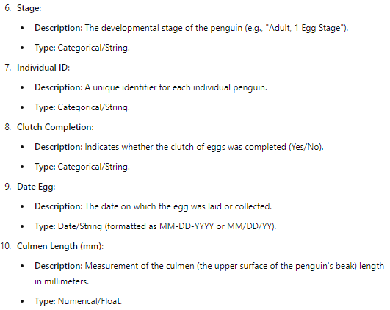

Slide 12
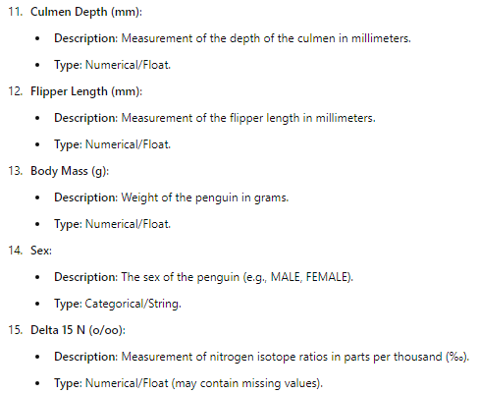
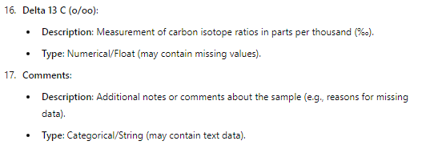

Slide 13
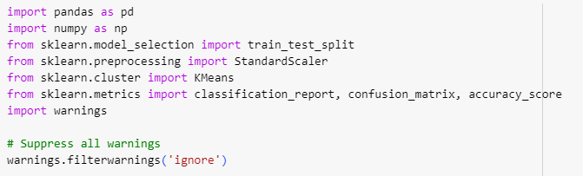



Slide 14




Slide 15


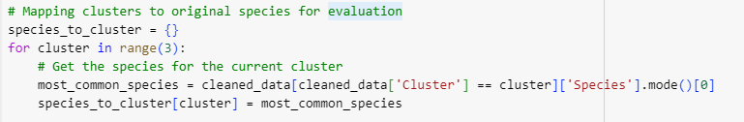


Slide 16
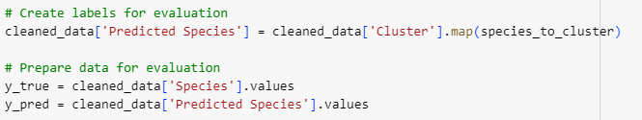
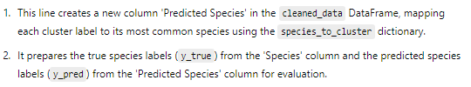
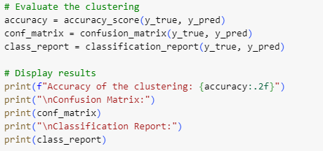
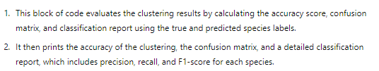

Slide 17
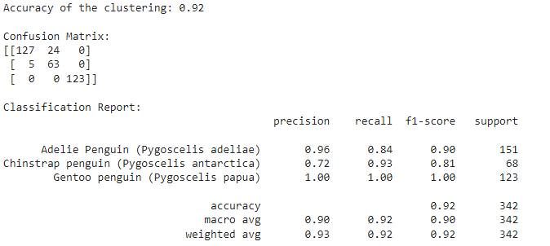


Slide 18
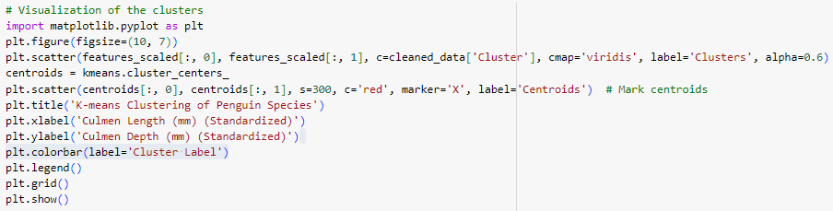
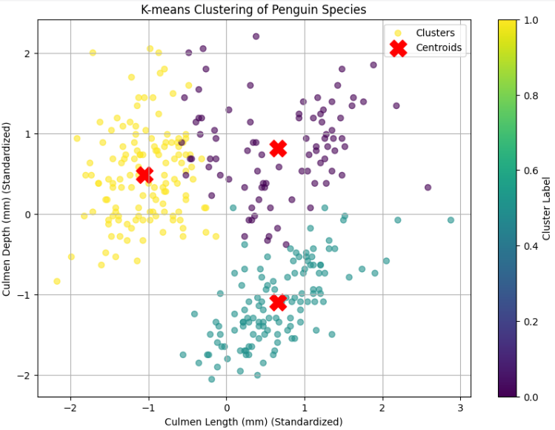
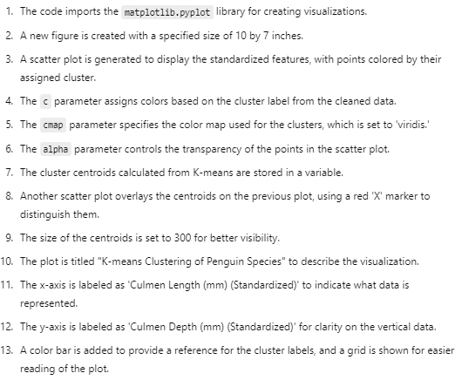

Slide 19
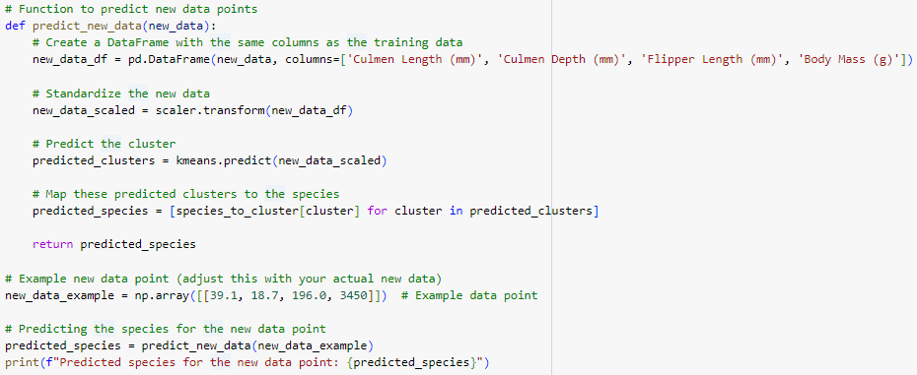
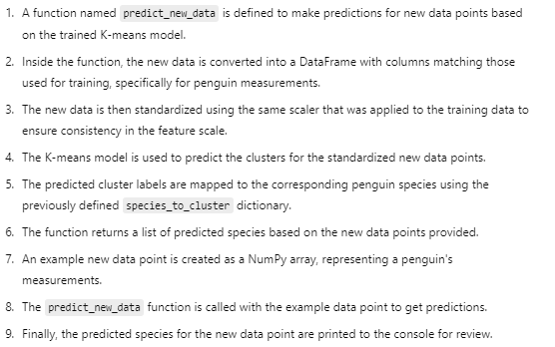

Slide 20


